Slide 2
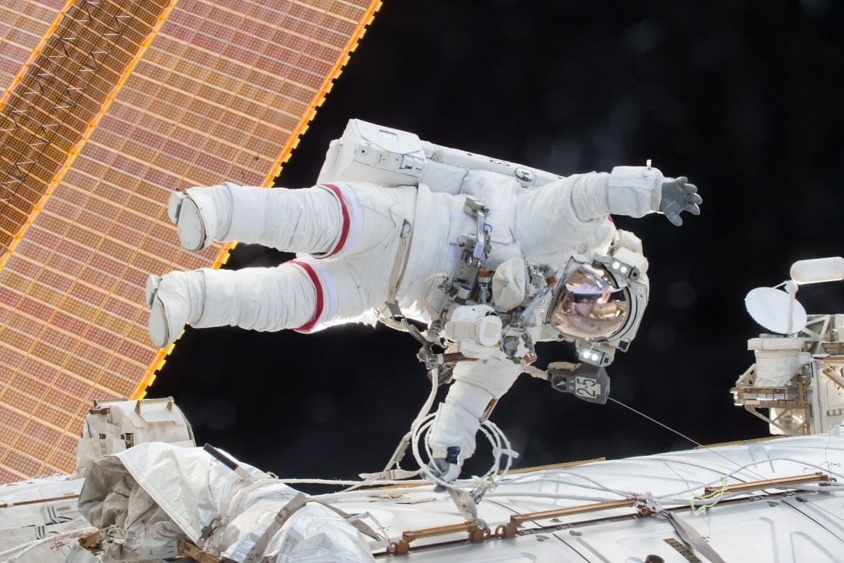
Astronauts
An astronaut is someone who is trained to travel in a spacecraft, live in space and carry out scientific experiments.
?
Did you know?
The term astronaut means ‘sailor amongst the stars’.
Click the question mark for an interesting fact!

Slide 3
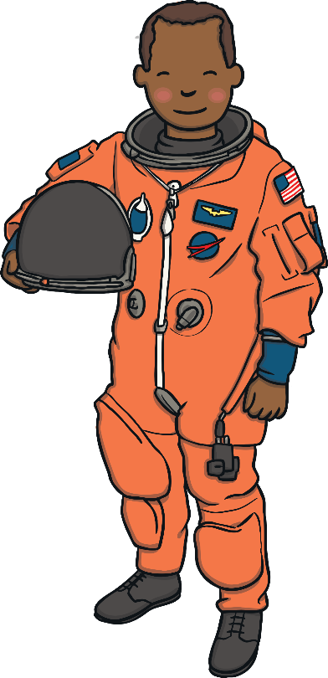
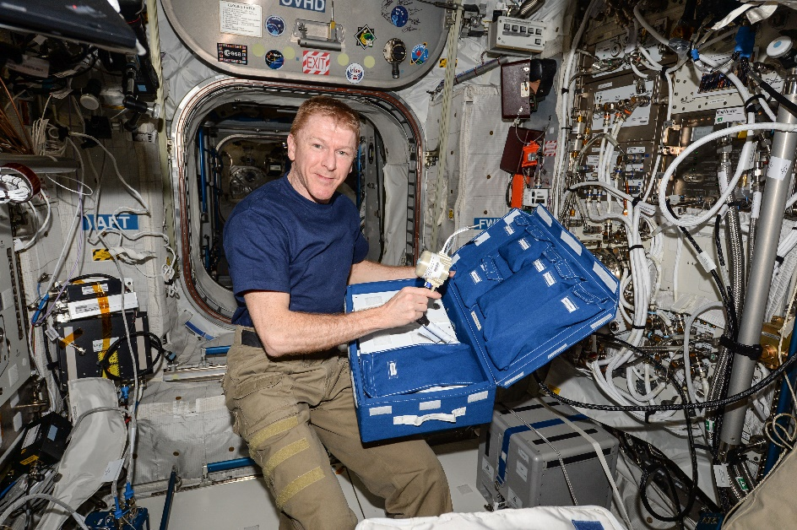
Astronauts
It takes several years to train to become an astronaut.
In this time, astronauts have to learn about science, space technology and how the International Space Station (ISS) works. They also have to be trained in basic medical care, learn how to scuba dive and also how to speak Russian!
Tim Peake is a British astronaut who lived and worked on the International Space Station from December 2015 to June 2016.
Photo courtesy of NASA(@Wikimedia Commons.com) - granted under creative commons licence – attribution

Slide 4
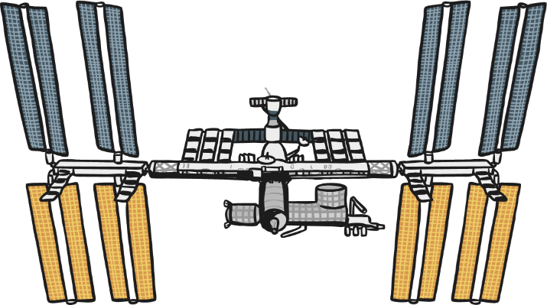
Where Do Astronauts Live in Space?
Astronauts live on the International Space Station (ISS).
It is a large spacecraft and laboratory that orbits the Earth.
It is used for carrying out research on the effect of living and working in space.
The ISS is made up of different parts called modules. These are where the astronauts sleep, live and carry out experiments.
?
Did you know?
The ISS travels around the Earth at 27,700 km/hr.
It completes 16 orbits of the Earth a day.
It travels 350km above the Earth.
It is big enough to cover a football playing field!
Click the question mark for an interesting fact!

Slide 5
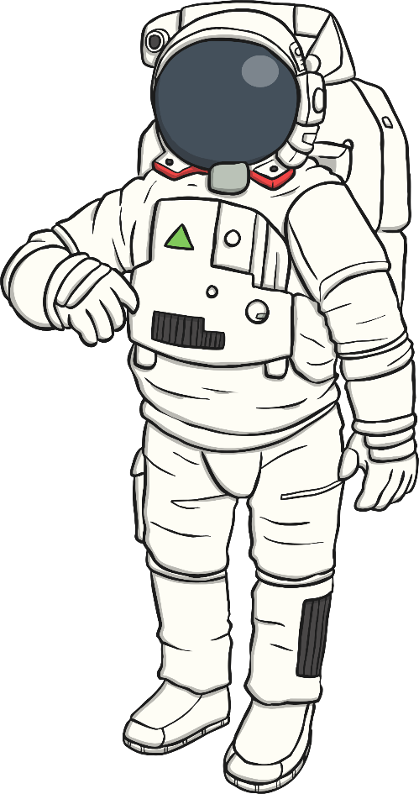
What Do Astronauts Wear?
When astronauts go on a spacewalk, they need to wear a protective spacesuit.
Click the question mark for an interesting fact!
x
Helmet – the visor protects the astronaut’s eyes from the strong rays of the Sun.
Camera (on helmet) – used to send pictures back to Earth.
x
+
+
Gloves – have a good grip. Astronauts need to train to carry out tricky tasks in these thick gloves
x
Primary Life Support System (on the back of the suit) – carries oxygen so that the astronaut can breathe. Water is also carried in this pack.
+
x
+
x
+
Display and Control Module (on the front of the suit) – the astronaut can control the spacesuit using these switches.
x
+
Radio – used to talk to other astronauts and Mission Control.
x
+
Spacesuit – keeps the astronaut’s body at the right temperature; it can get very cold and very hot in space.

Slide 6
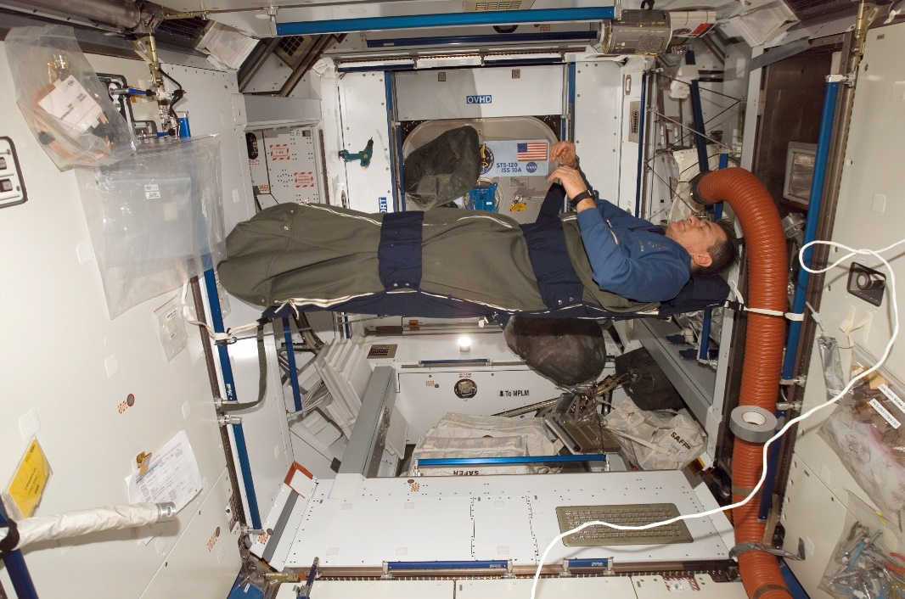
How Do Astronauts Sleep in Space?
Sleeping on board the ISS is a bit different for astronauts than it is for you at home.
Zero gravity means that the astronauts float around so they need to sleep in sleeping bags that they attach to the walls, ceiling or floor.
This means that they will not bump into anything as they sleep! Crew members also have their own cabins to sleep in.
Discover
Click on the picture for a tour of the sleeping quarters on board the ISS!
Photo courtesy of NASA(@Wikimedia Commons.com) - granted under creative commons licence – attribution

Slide 7
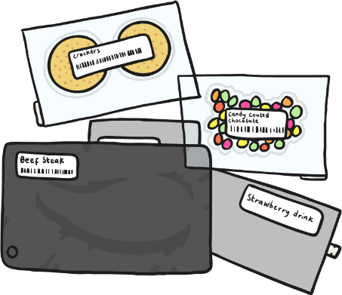
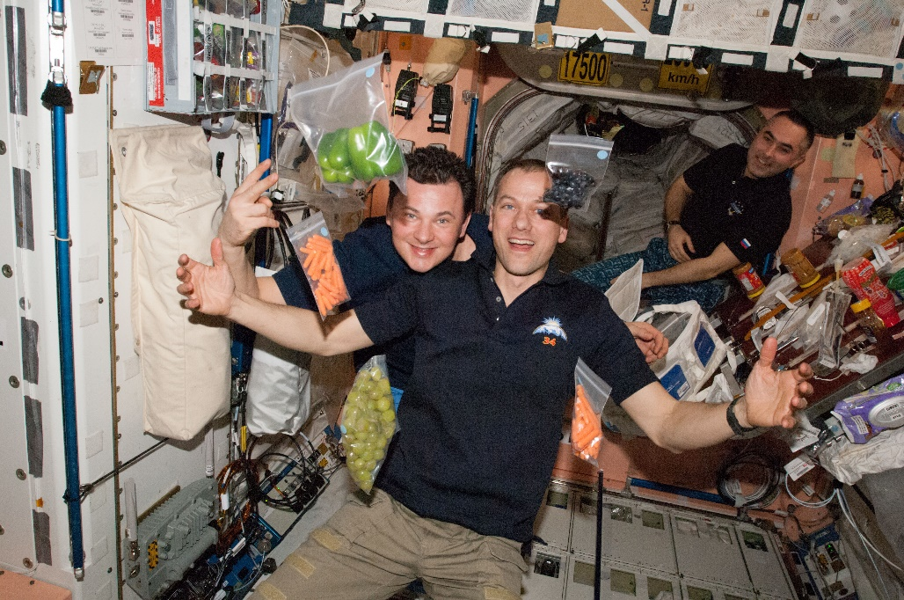
What Do Astronauts Eat and Drink?
Astronauts can eat many of the same foods that you
eat at home but the way they are packaged has to
be different because food and crumbs will fly around
in zero gravity!
Food and drink may be packaged in aluminium foil or canned. Astronauts may need to add water to food if it is freeze-dried or they may need to heat it up before they eat it.
Photo courtesy of NASA(@Wikimedia Commons.com) - granted under creative commons licence – attribution

Slide 8
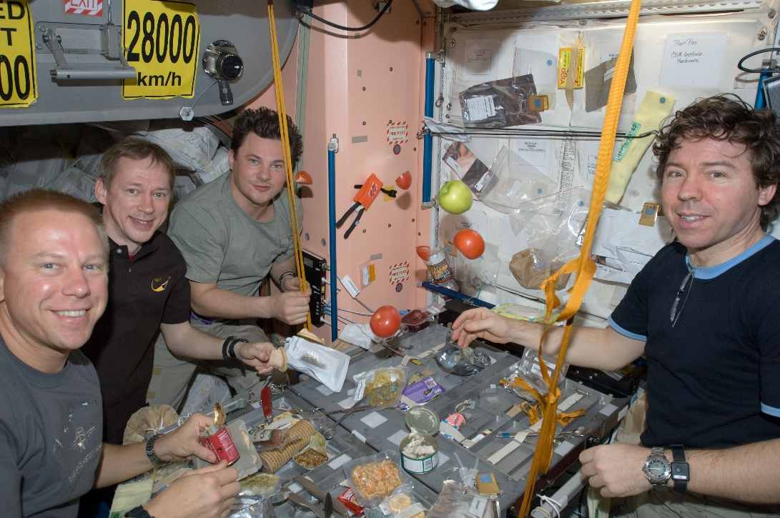
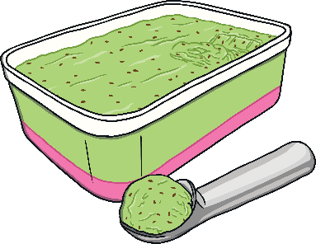
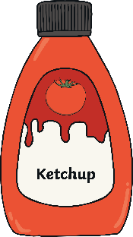
What Do Astronauts Eat and Drink?
Astronauts get to choose their favourite foods before they go into space
This may include frozen meals, frozen vegetables and desserts, as well as refrigerated dairy products. They are provided with snacks and even ketchup!
Photo courtesy of NASA(@Wikimedia Commons.com) - granted under creative commons licence – attribution

Slide 9
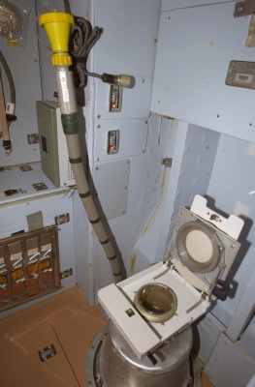
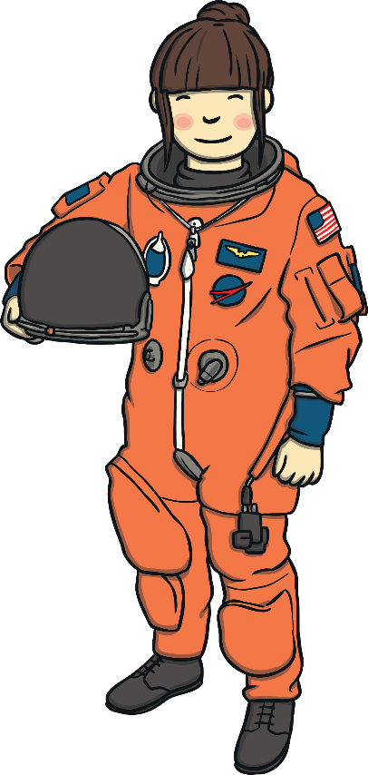
How Do Astronauts Go to the Toilet in Space?
Discover
Watch the video to see Tim Peake explain how astronauts go the toilet in zero gravity!
Click on the photo to
view the video.
Photo courtesy of NASA(@Wikimedia Commons.com) - granted under creative commons licence – attribution

