Slide 2
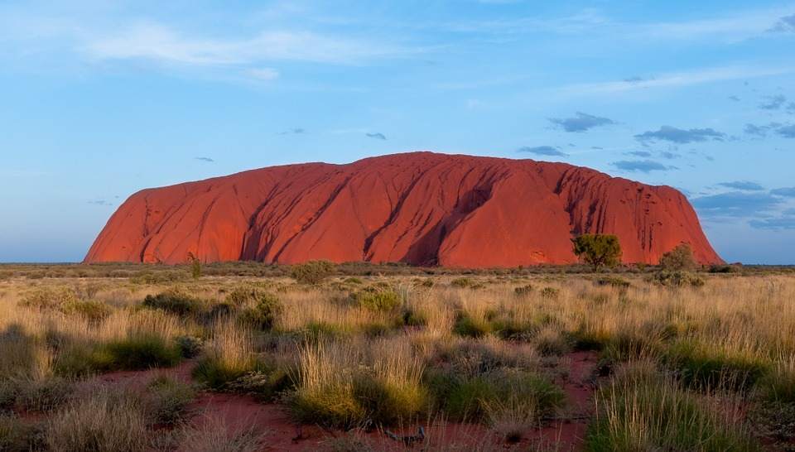
Uluru
Ulruru is one of Australia’s most famous and recognisable landmarks.

Slide 3
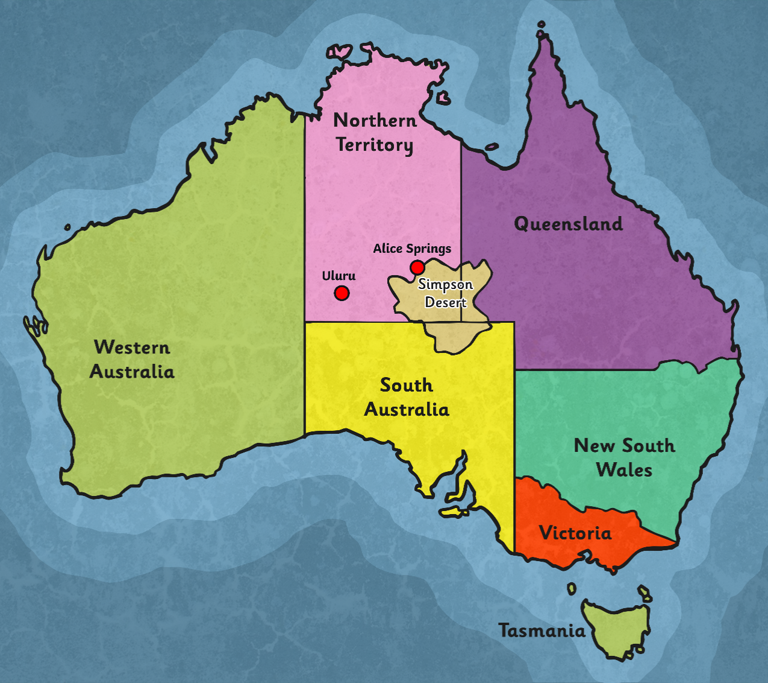
Location
Uluru is located in the “Red Centre”, west of the Simpson Desert. It is about 460km southwest of Alice Springs in the Northern Territory.
It is located in the Uluru-Kata Tjuta National Park and is listed as a World Heritage Site by UNESCO.

Slide 4
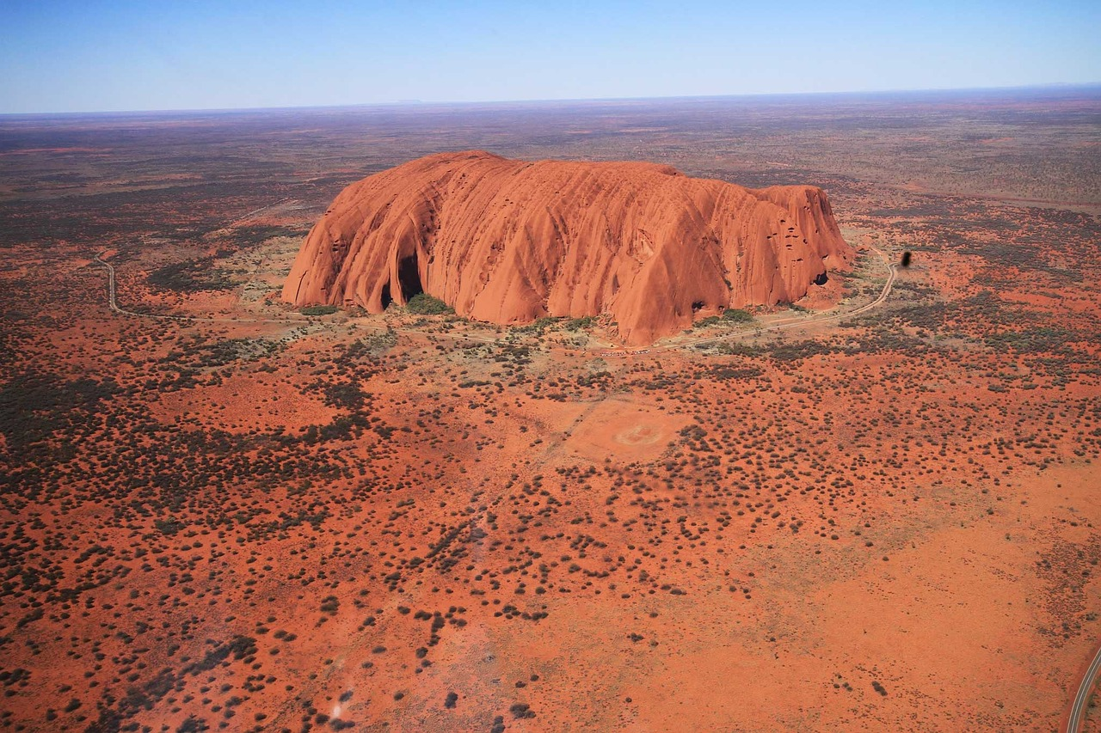
Facts
Uluru is the Aboriginal and official name for this amazing rock, but it is also known as Ayers Rock. It was named after Sir Henry Ayers, the eighth premier of South Australia.
It is about 600 million years old.
Geologists refer to Uluru as an inselberg which means "island mountain".

Slide 5
Size
Ulruru is:
348m high
863m above sea level
3.6km long
1.9km wide
9.4km around the base
It covers approximately 3.33 km² and extends about 2.5km into the ground (although nobody knows exactly how far down it goes!)

Slide 6
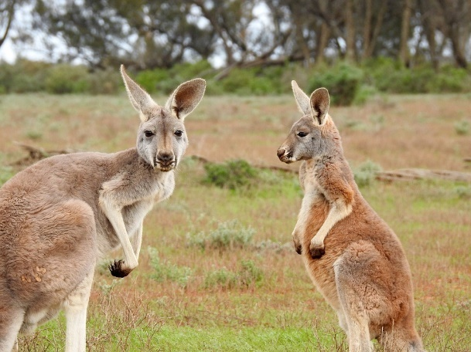
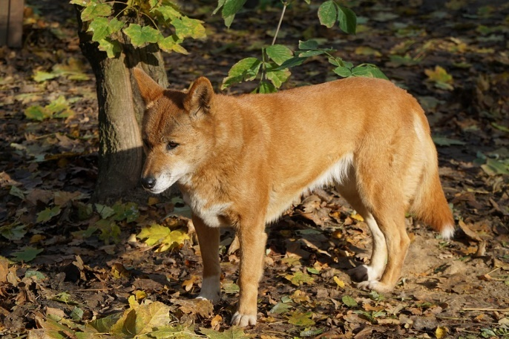
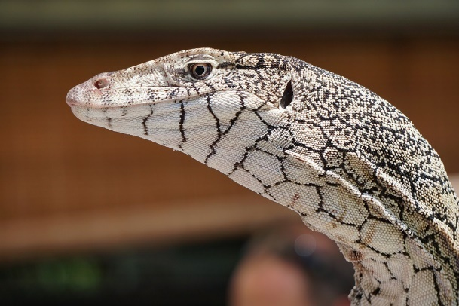
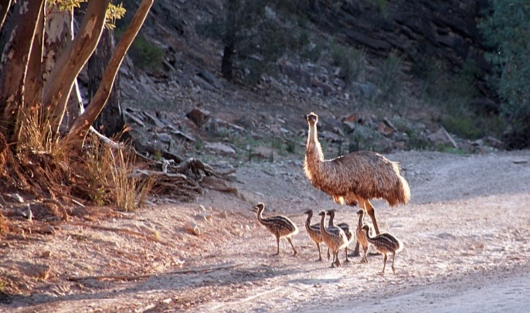
Animals
According to historical records, 46 species of native mammals have lived near Uluru. Some recent surveys have said there are currently 21 species living nearby. Some of the animals include: Bats, frogs, red kangaroos, rock wallabies, perenties, sand goannas, dingoes and emus.
Many people are trying to reintroduce locally extinct animals such as the mala, brushtail possum and bilby to the area.

Slide 7
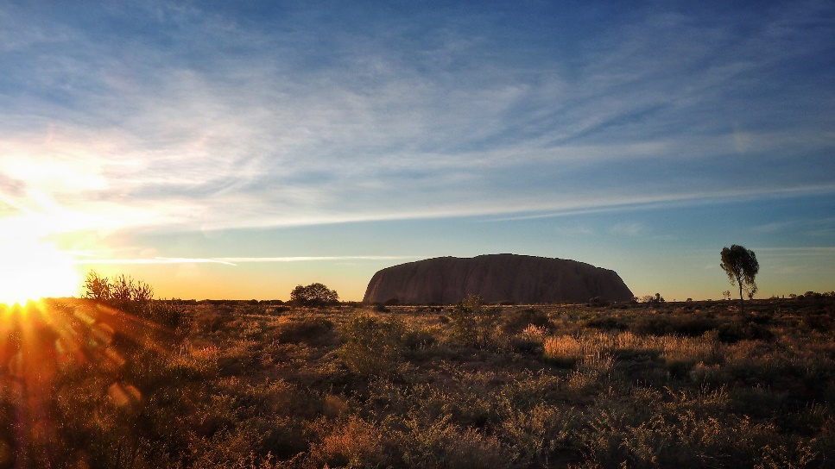
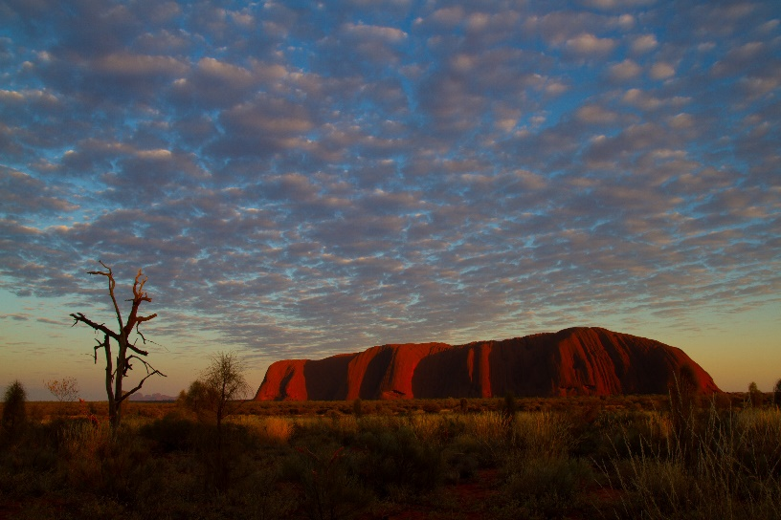
Climate
The Uluru-Kata Tjuta National Park is a desert environment and has a hot climate.
The sunrises and sunsets at Uluru are known for being some of the most beautiful in Australia.
The average high temperature in summer (between December-January) is 37.8°C and the average low
temperature in winter (June-July) is 4.7°C.
Photos courtesy of Leo Li and Tchami (@flickr.com) - granted under creative commons licence – attribution

Slide 8
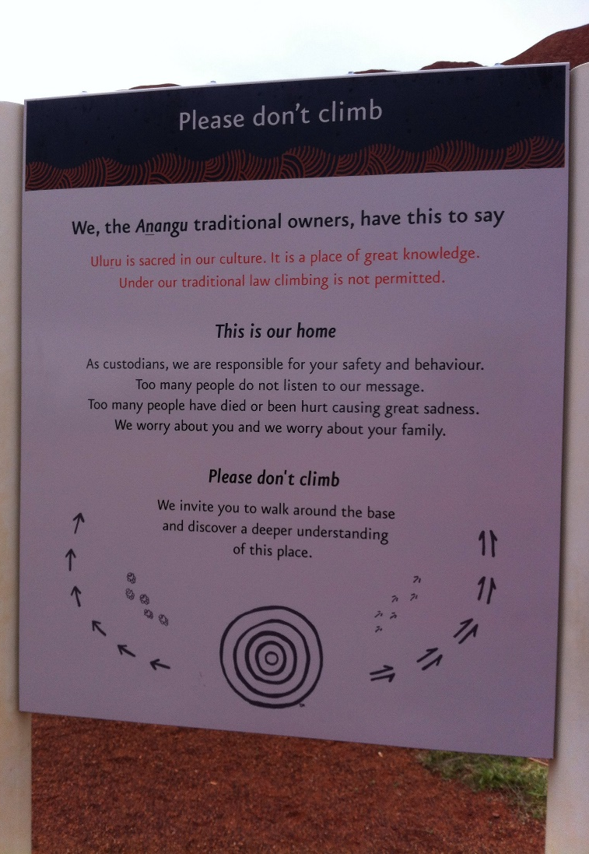
Climbing
Uluru is a very popular tourist destination and attracts many visitors year round who come to see the beautiful landmark in person.
The local Aṉangu people and visitors who respected their culture did not climb Uluru because of its great spiritual significance.
Visitors began climbing Uluru in the late 1930s. The local people asked that visitors do not climb Uluru, as the path crosses a sacred, traditional ‘Dreamtime’ track. They were also concerned about the danger and safety of visitors as it was a very difficult climb. The climb was finally closed to visitors in 2019.
Photos courtesy of Ellen Forsyth @flickr.com) - granted under creative commons licence – attribution

Slide 9
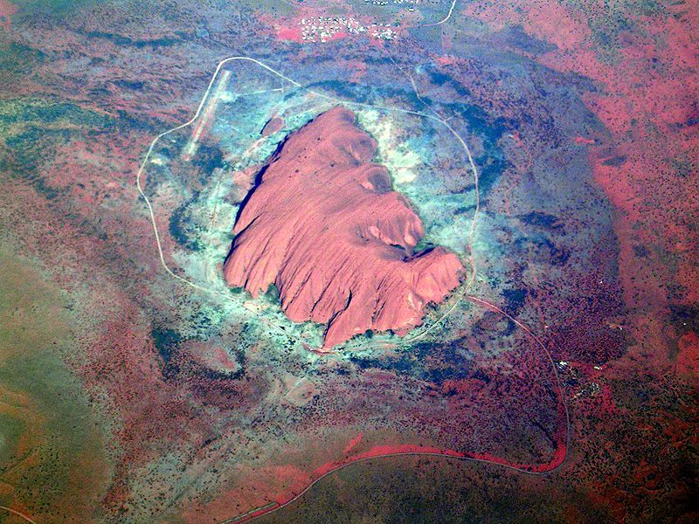
Aerial View
Photos courtesy of Ellen Forsyth @flickr.com) - granted under creative commons licence – attribution

Slide 10
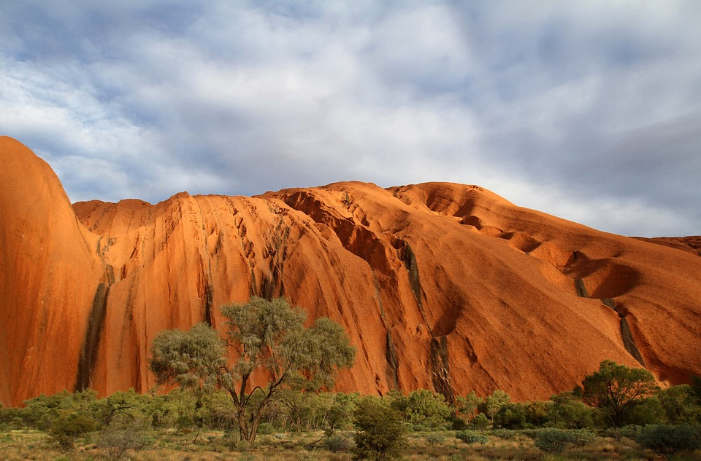
Uluru Close Up
Photos courtesy of Ellen Forsyth @flickr.com) - granted under creative commons licence – attribution

