Slide 1
Welcome to Year 1
We hope that this will be an exciting and challenging
year for your child.

Slide 2
Miss McAvoy: Monday-Friday (Somer class)
Miss Ryan: Monday-Friday (Frome class)
Miss King: All week (Somer class)
Mrs T Mason: All week (Frome Class)
Mrs S Mason and Mrs Clarke: Thursday pm

Slide 3
Transition from Reception to Year 1.
Our aim is to ensure that children experience a smooth transition from the Foundation stage to Key Stage one.
The year one curriculum builds upon and extends the experiences that children have had in Reception.

Slide 4
Mornings
The children are settling into new routines in the mornings.
We will encourage your child to be as independent as possible in the mornings e.g. putting their own lunchbox/ book bag away.
Please ensure your child brings in their reading record and communication book each morning to be checked.
As a school we encourage your child to just bring in their bookbag and a water bottle in each day.
Please ensure your child brings in their pe bag every Monday.

Slide 5
Reading
Children will change their reading books weekly.
Some children may need to keep their books for longer to make sure they can read it fluently, recognise familiar words and show good understanding of the text.
We strongly encourage you to read with your child daily as this will benefit their learning across the curriculum.
We are beginning to establish guided reading routines.

Slide 6
Book bags
Please keep your child’s reading record and blue parent communication book in the bag.
Children who are still working through their phonics folders will continue to do so. Please revise these sounds regularly.
Please try to read at home every night, even if it is just a few pages and sign the reading record.

Slide 7
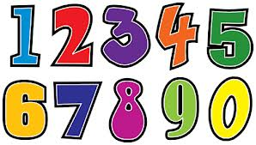
Number bonds
Every week we will be doing a short number bonds test.
The children have 5 minutes to answer a set number of questions as we are trying to improve their rapid recall of number facts.
Children may find this hard to begin with but with regular practice at home and school their scores do improve.
Although we encourage children to beat their own score, they must not compare their scores to others.
We would also encourage you to practice the correct number formation with your child at home.
Each week they will bring their sheet home and we would appreciate it if they could practise the corrections at home with you.
We will let you know which day this will take place, following October half term.

Slide 8
Times Tables
As the year progresses, children will also be tested on their times tables.
You will be notified before the children begin to be tested later on in the year.
By the end of year 1, children should be confident with 2, 5 and 10 times tables.

Slide 9
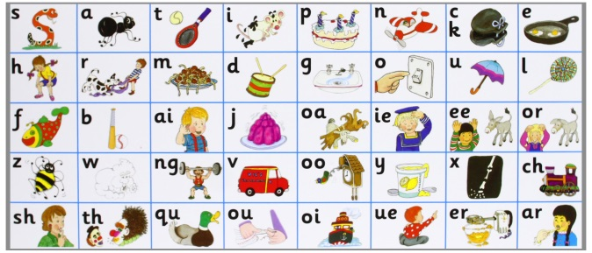
Phonics
Phonics will be taught daily in Year 1 and the children will be assessed at the end of each term to see how many sounds they are able to recognise.
A copy of any sounds your child needs to practice reading will be sent home at the end of each term as well.
In Year 1 the children will have a phonics screening check during June and the result will be reported to you.
Children will have practice screenings throughout the year where they will be reading a variety of real and alien words.

Slide 10
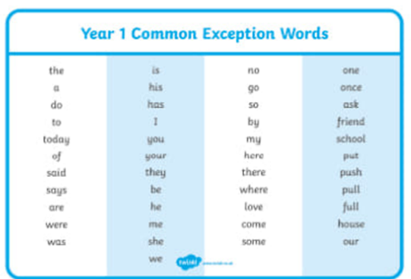
Spellings
Once children are settled they will begin learning spellings.
Each week we will send home appropriate spellings for your child.
Children will be tested on Fridays and scores will be sent home.
We will also do a spelling test termly, just focusing on Year 1 common exception words.
A copy of this will be sent home which will allow you to see which words need to be practiced more. There is also a copy of this on the year 1 page
of the school website.

Slide 11
General reminders
The children will be doing P.E on Wednesday and Friday.
Please ensure your child has their P.E kit in school and that all items are clearly labelled.
We encourage children to practise getting dressed at home to help them get changed quickly at school.

Slide 12
Water bottles
Children need to provide a water bottle to keep in class which they can access throughout the day.
Please make sure your child’s name is written clearly on their water bottle.
Water bottles will be sent
home daily to be cleaned.

Slide 13
You can help your child this year by:
• Reading together regularly and sharing books at home.
• Working with them to practice spellings and number skills.
• Talking about everyday maths such as money, telling the time and measuring weights and lengths and recognising shapes.
You play a crucial role in helping your children learn. Children achieve more when schools and parents work together in partnership.

Slide 14
Please don’t hesitate to contact us if you have any questions or queries.
Any questions?

Slide 15
Any questions?

