Slide 2
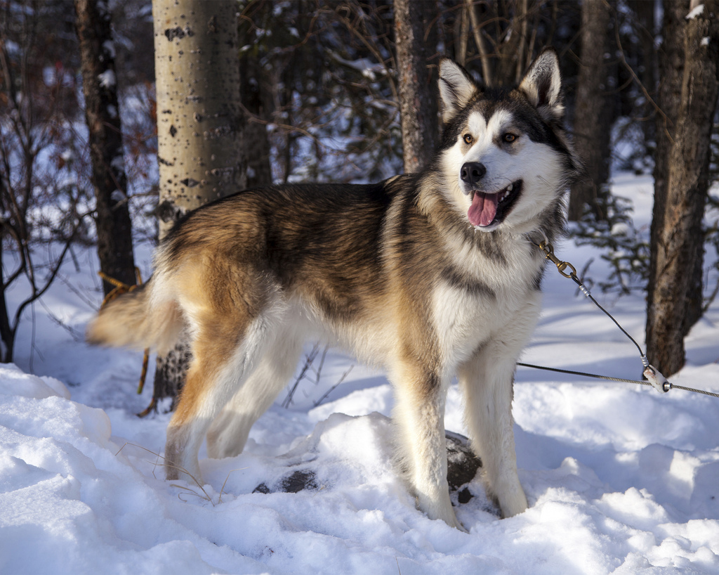
What can you see?

Slide 3
Husky
Photo courtesy of DenaliNPS (@flickr.com) - granted under creative commons licence - attribution

Slide 4
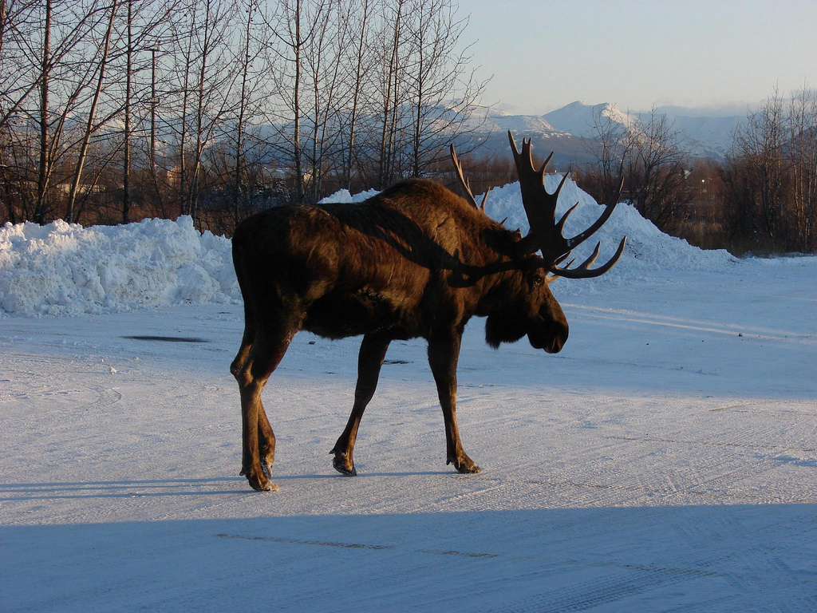
What can you see?

Slide 5
Moose
Photo courtesy of echoforsberg (@flickr.com) - granted under creative commons licence - attribution

Slide 6
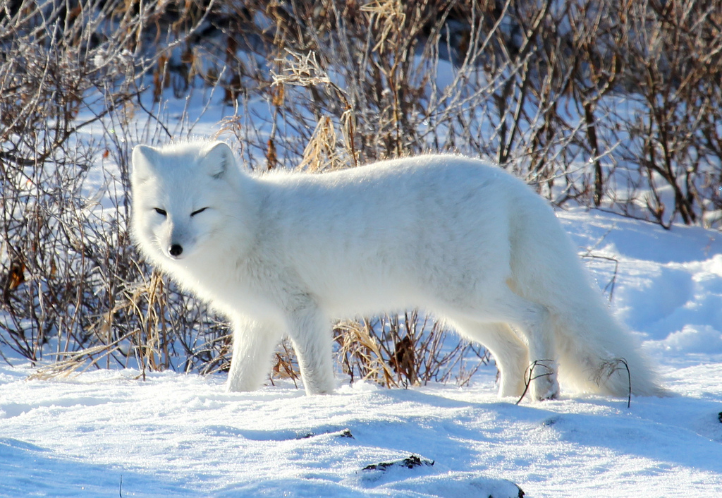
What can you see?

Slide 7
Arctic Fox
Photo courtesy of em_j_bishop (@flickr.com) - granted under creative commons licence - attribution

Slide 8
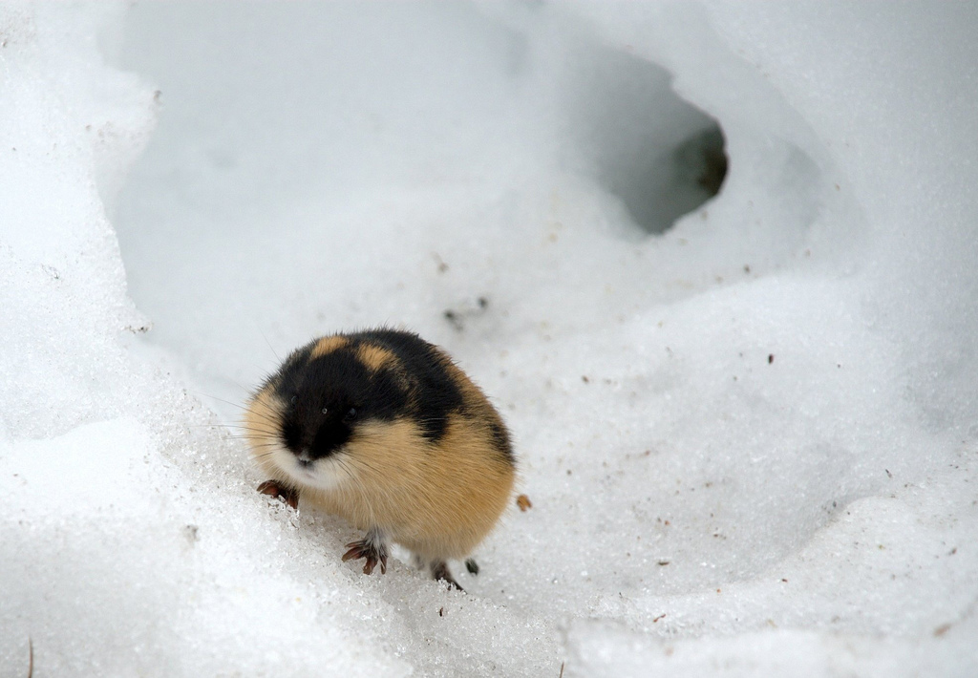
What can you see?

Slide 9
Lemming
Photo courtesy of kgleditsch (@flickr.com) - granted under creative commons licence - attribution

Slide 10
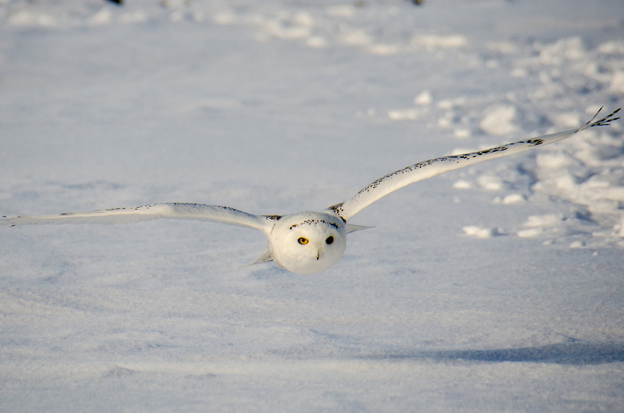
What can you see?

Slide 11
Snowy Owl
Photo courtesy of m01229 (@flickr.com) - granted under creative commons licence - attribution

Slide 12
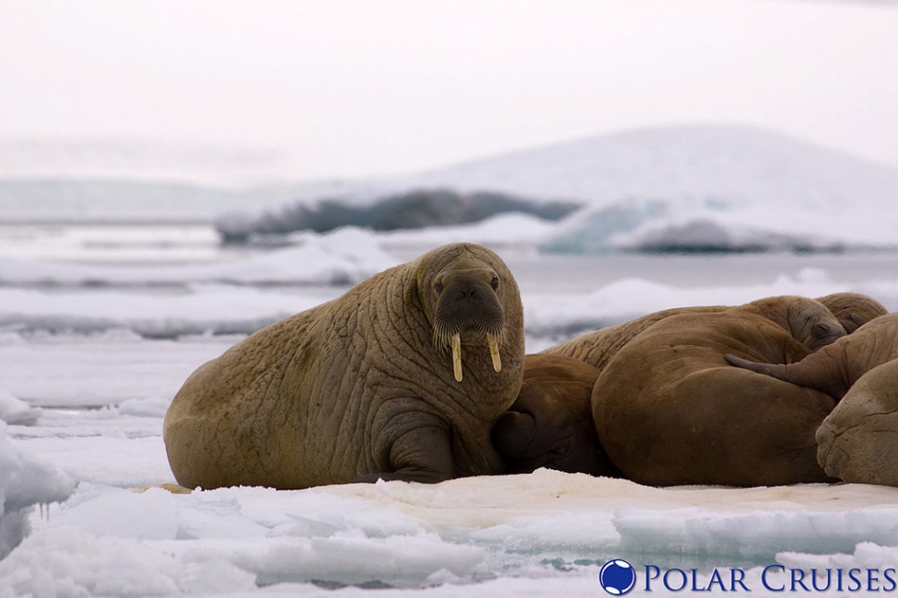
What can you see?

Slide 13
Walrus
Photo courtesy of Polar Cruises (@flickr.com) - granted under creative commons licence - attribution

Slide 14
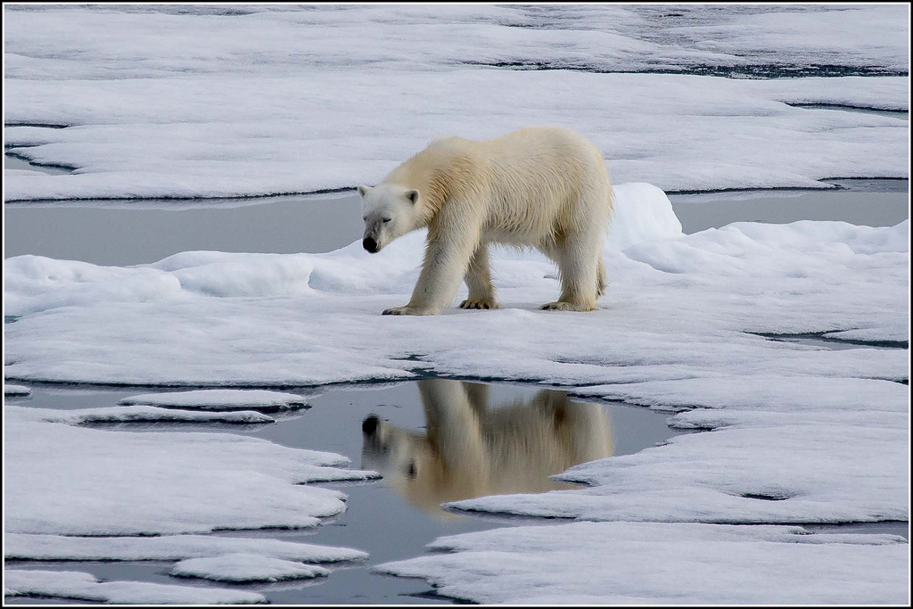
What can you see?

Slide 15
Polar Bear
Photo courtesy of Smudge 9000 (@flickr.com) - granted under creative commons licence - attribution

Slide 16
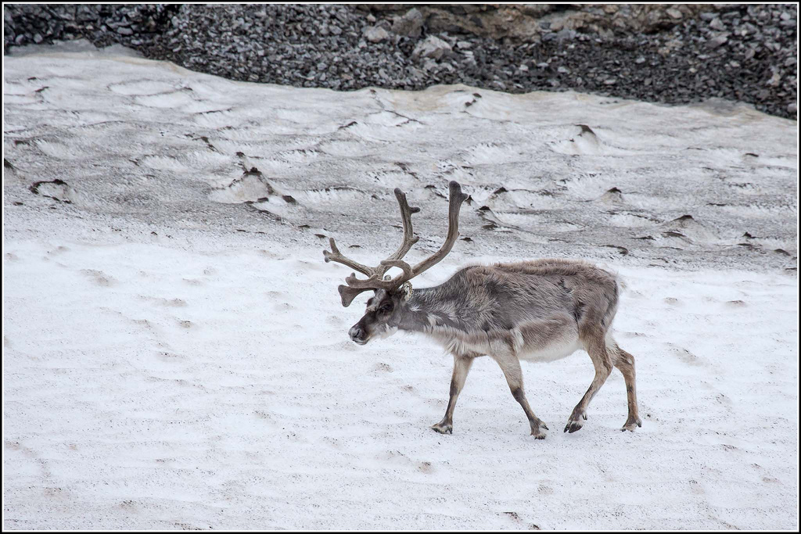
What can you see?

Slide 17
Reindeer
Photo courtesy of Smudge 9000 (@flickr.com) - granted under creative commons licence - attribution

Slide 18
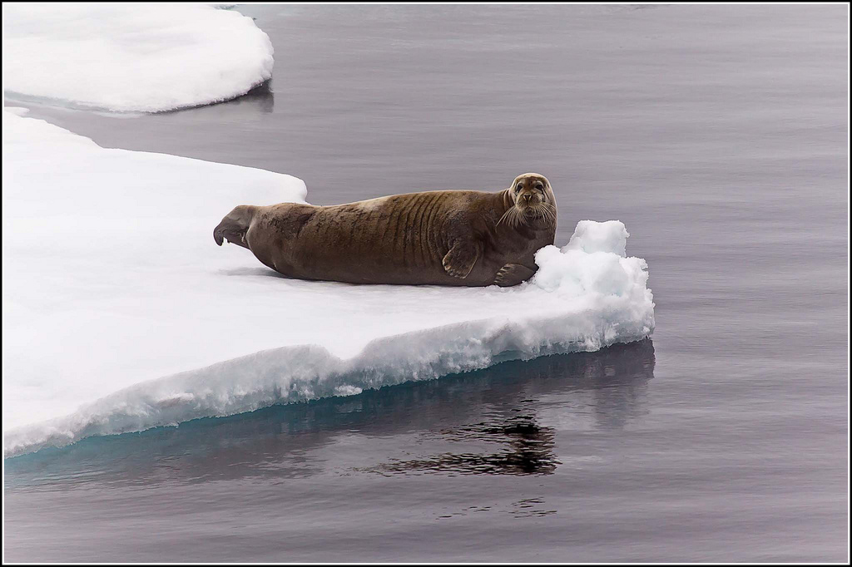
What can you see?

Slide 19
Seal
Photo courtesy of Smudge 9000 (@flickr.com) - granted under creative commons licence - attribution

Slide 20
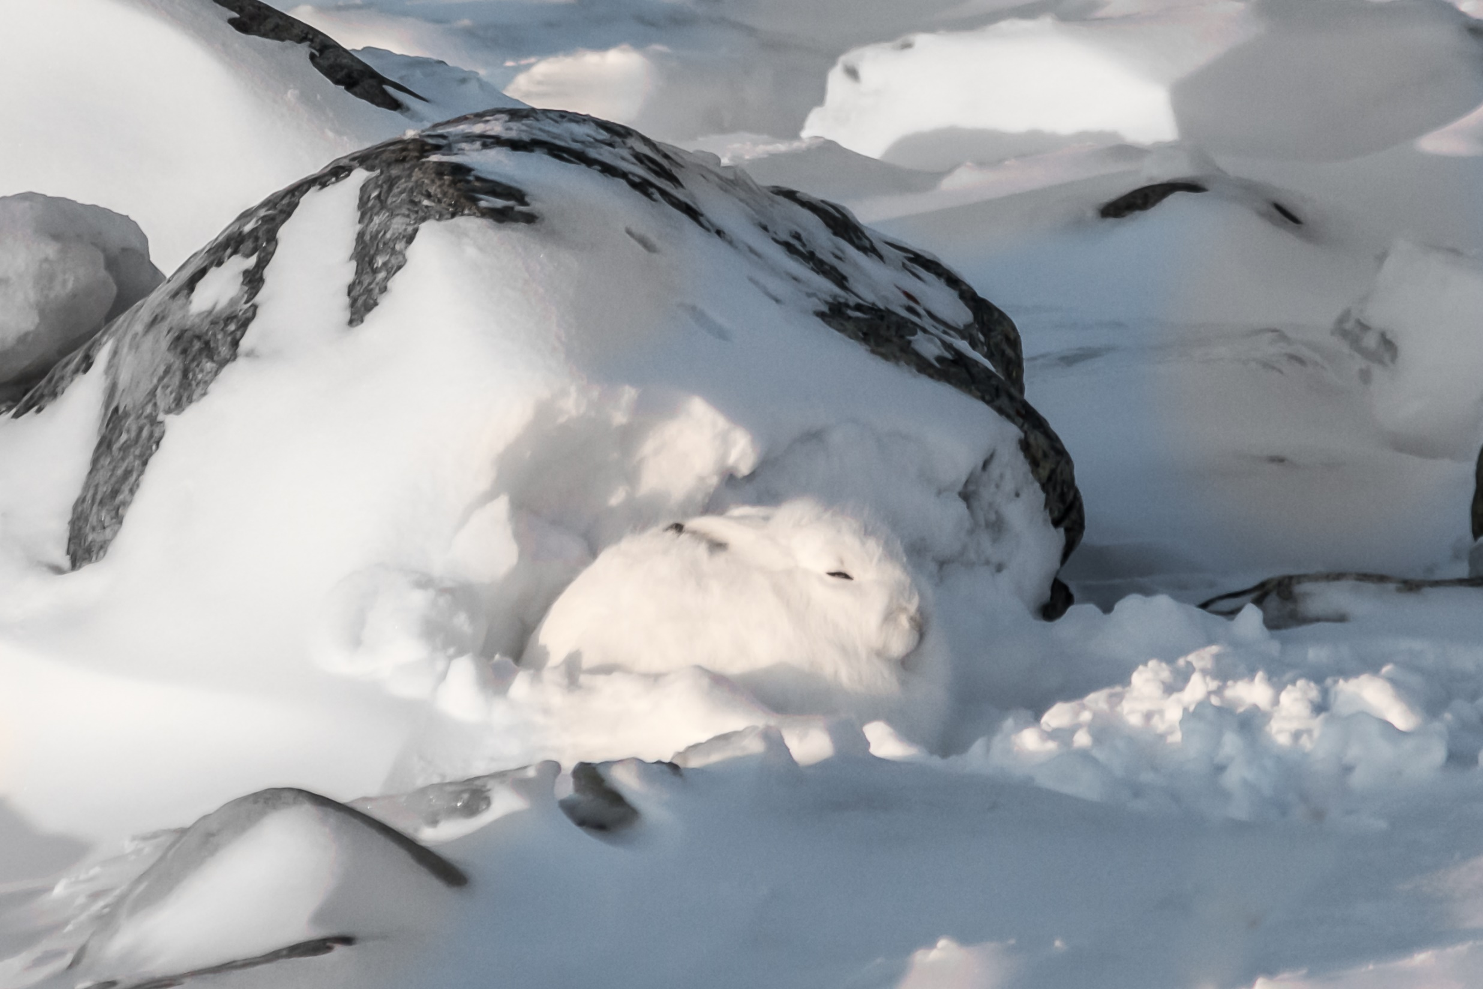
What can you see?

Slide 21
Arctic Hare
Photo courtesy of helenehoffman (@flickr.com) - granted under creative commons licence - attribution

