Slide 2
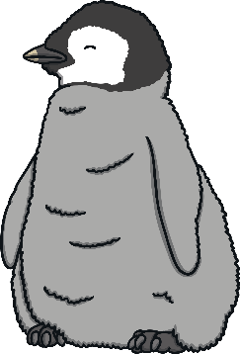
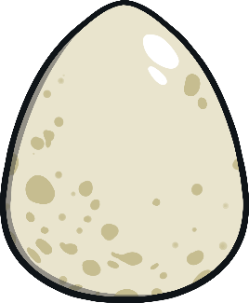

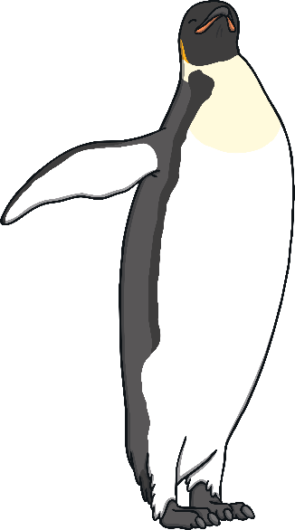
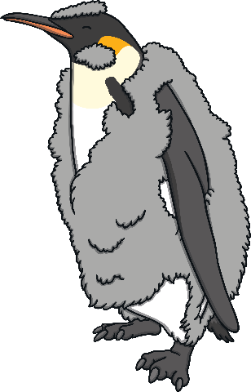
egg
chick
The Life Cycle of a Penguin
adult penguin
fledgling
Interesting Facts

Slide 3

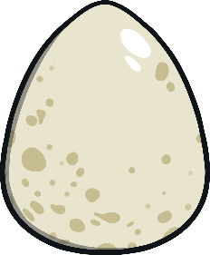
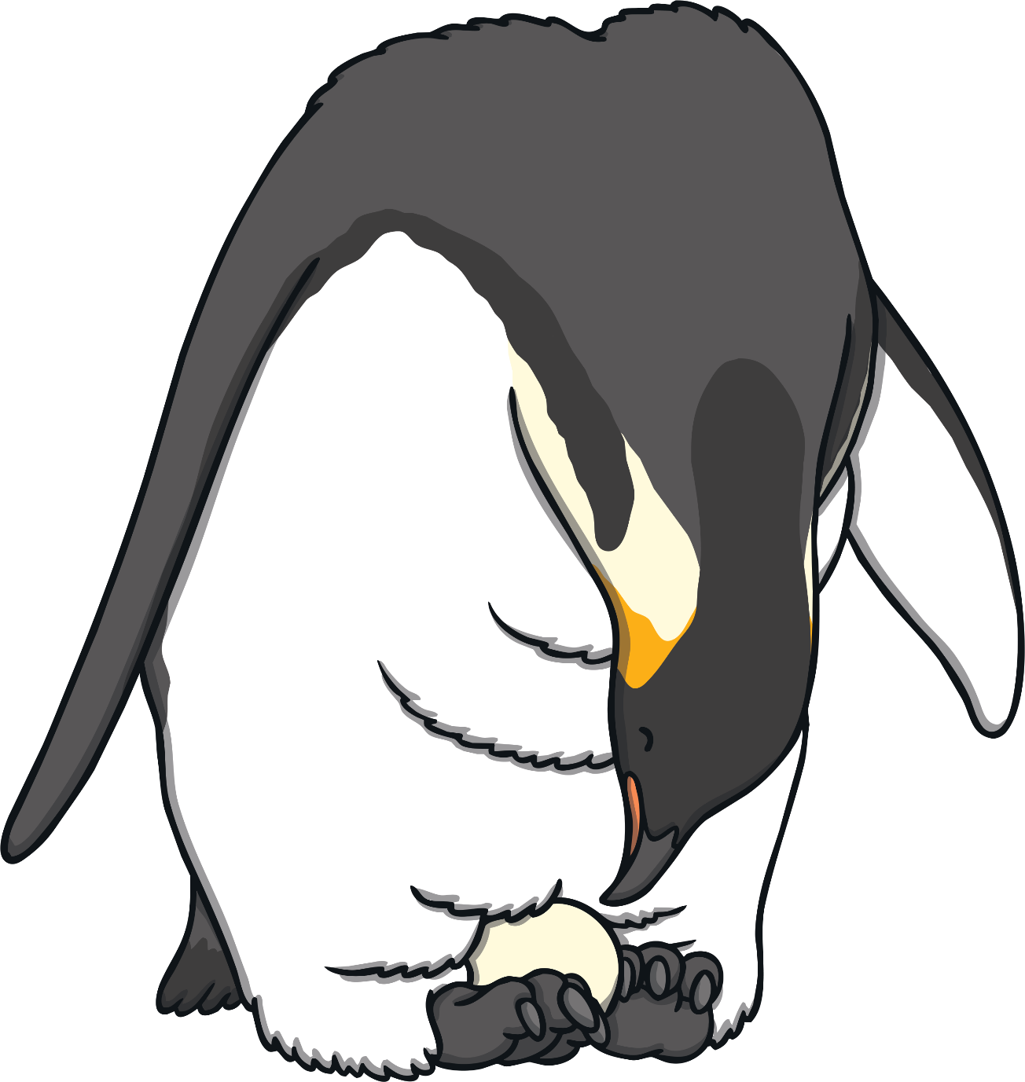

    The female penguin usually lays two eggs. This is called a clutch.
egg
    Penguin partners usually share keeping the eggs warm. This is called incubating.
  Did You Know…?
  King penguins and emperor penguins lay only one egg each year.
  Also, an emperor penguin egg is looked after all winter by the male.
  Back

Slide 4
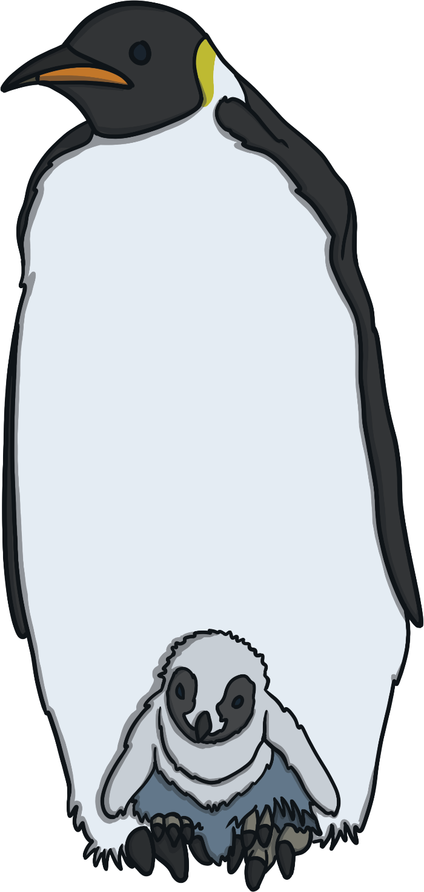
    When the chicks are ready, they hatch out of their egg.
chick
    They poke a small hole in the egg with their beaks.
    Their feathers are soft and downy. The chicks need their parents to
    feed and look after them.
  Did You Know…?
  It can take nearly three days for a chick to hatch from its egg!
  Back

Slide 5


      The chick must grow new waterproof feathers before it can go out to sea (fledge).
fledgling
    When it has waterproof feathers, the fledgling is independent.
  Did You Know…?
  The adults feed the chick food from their own stomachs. This is called regurgitating.
    It can dive and hunt for food by itself.
  Back

Slide 6


  Penguins spend half their time on land, half in the sea.
Adult Penguin
  They can take a few years to be ready to find a mate.
    Penguins can live up until 20 years old!
  Back

Slide 7
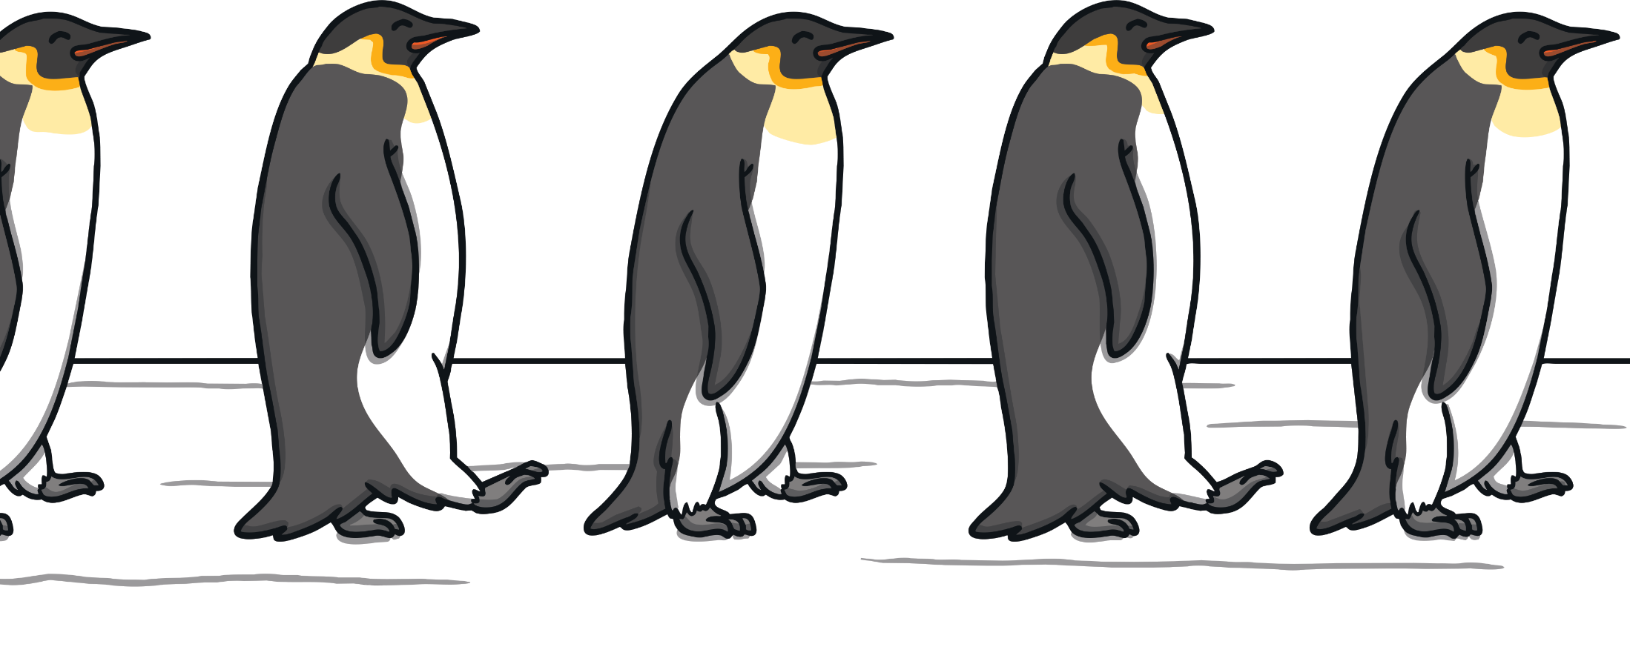
  Interesting Facts
  Penguins are birds but they cannot fly.
  They use their wings to help them swim.
  Penguins live together in a group called a colony.
    Penguins can live up until 20 years old!
  Back

